Slide 1
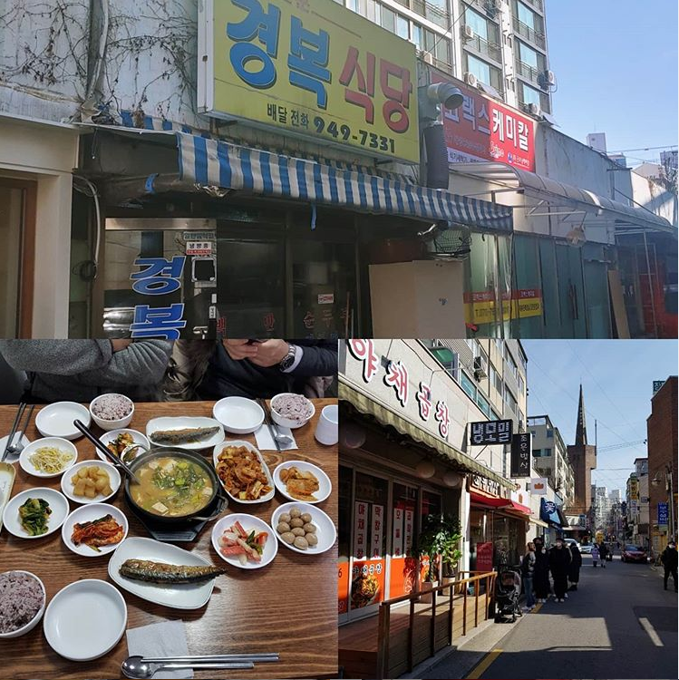
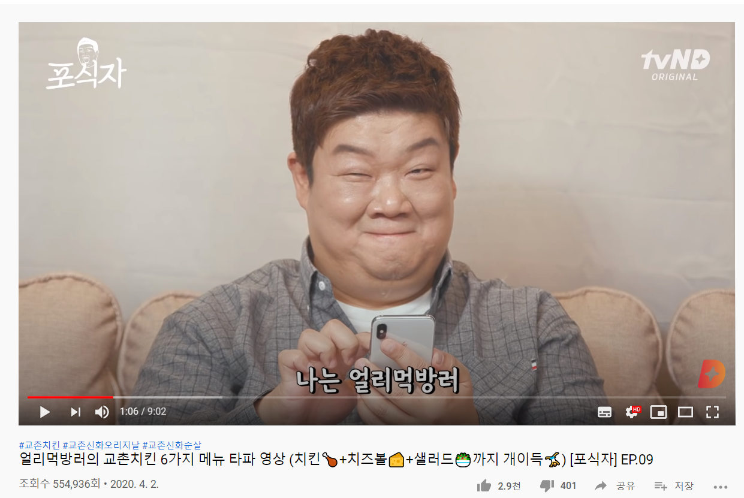
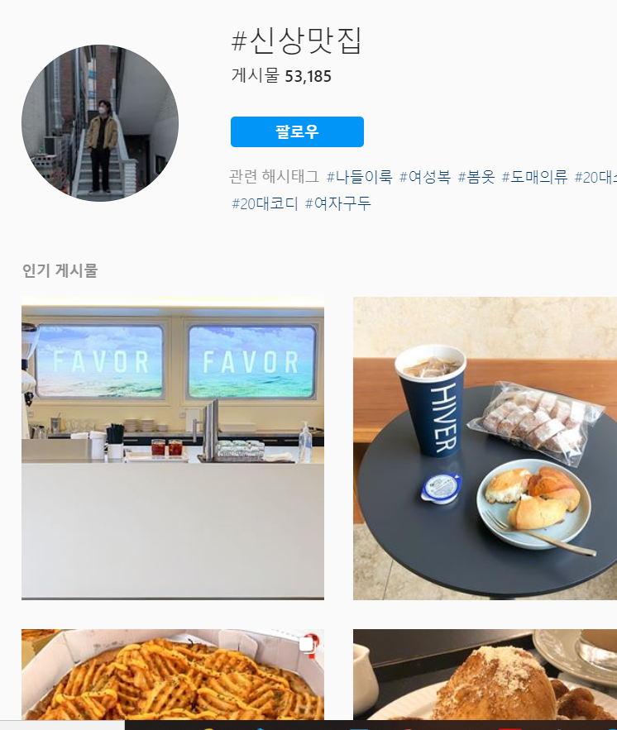
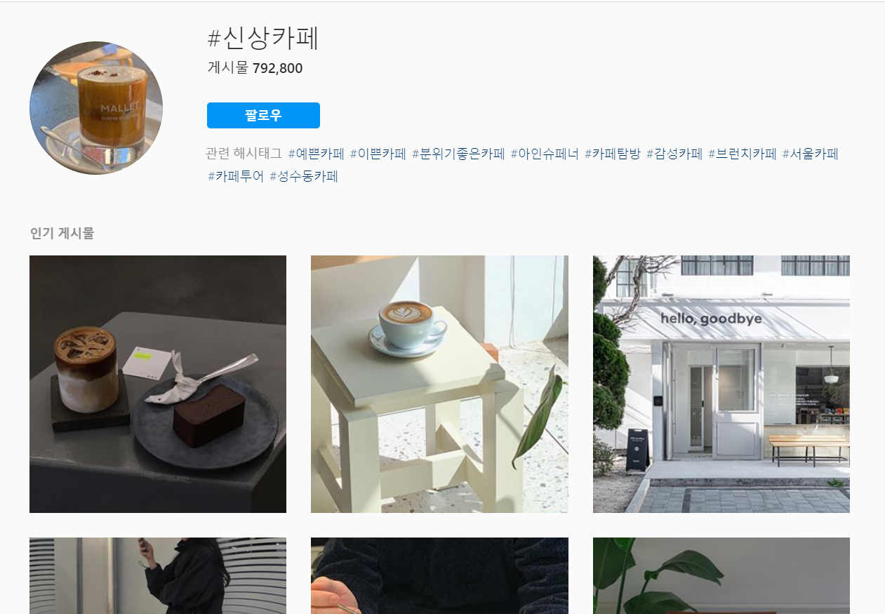
MOTIVATION & IDEA
Motivation
Many people are interested in new restaurants and new foods and try to go before they become famous. For example, “골목식당 미리투어“ , New menu review contents at “Youtube” , Hash-tag at Instargram related new restaurant and café.
Idea
Develop a new app that shows shops recently opened or will broadcast aim to people want to go before others. And when reviews of new restaurants are piled up, we take the data and make a list of restaurants app.

Slide 2
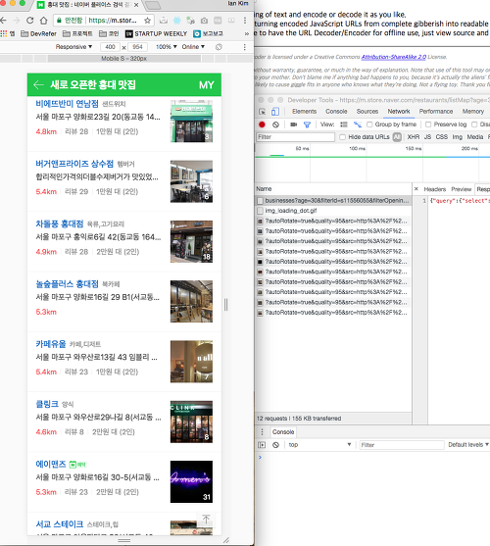
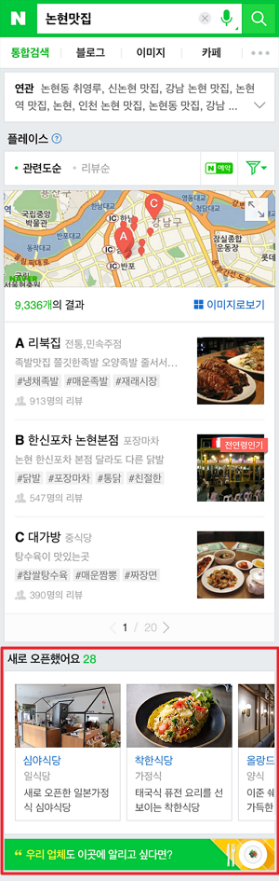
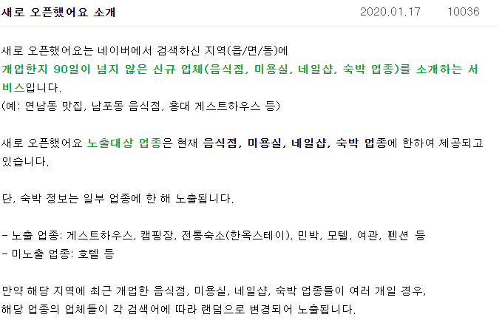
IMPLEMENTATION-PLAN & BUSINESS-MODEL
Implementation plan
To continue uploading newly opened restaurants and cafes, I will receive a list of new stores using the NAVER SmartPlace API. And I’m going to collect new store reviews and build an algorithm that shows gourmet food like a ‘Mango-plate’ and makes it look good to users, “separate showing new store.”
Business Model
If service users increase to a certain extent and reviews begin to accumulate,
Stores that pay advertising fees such as ‘Ultra Call’ of the ‘배달의 민족’ will benefit from increased exposure rates and extended exposure periods.
A beauty store existing in NAVER API like ‘Kakao-hair’ is managed to receive advertising expenses.
Sources:https://hwi0910.tistory.com/1

Slide 3
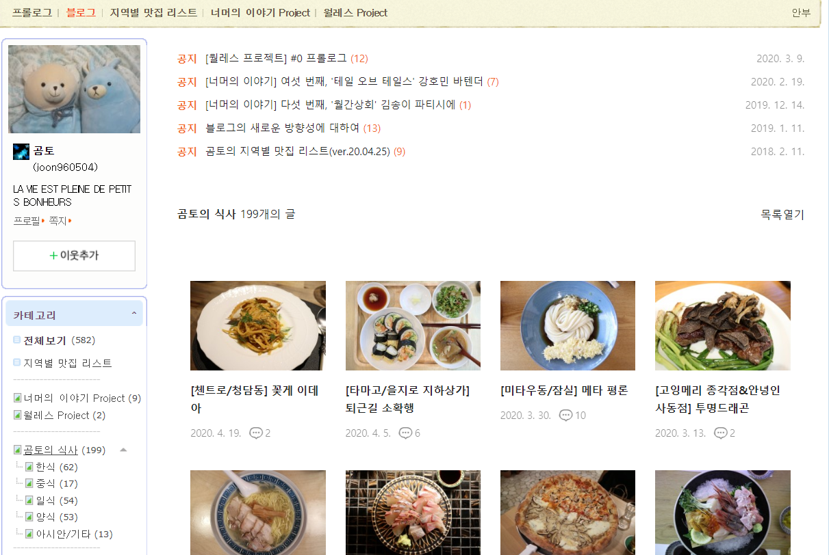
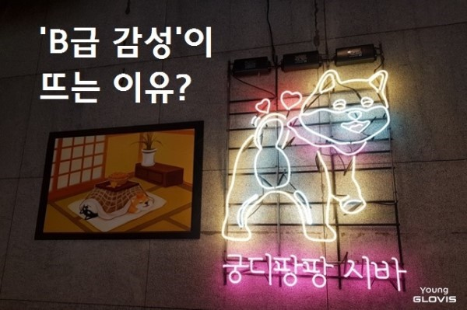
COMPETITIVE-ADVANTAGE & MARKETING-PLAN
Competitive Advantage
To continue uploading newly opened restaurants and cafes, I will receive a list of new stores using the NAVER SmartPlace API.
Restaurnat recommendation applications such as ‘Mango-plates’ provide objective and reliable information, so it's not easy to configure a business model. However, this app is easy to make money because there are parts to objectively evaluate and advertise.
As many young people, especially women, they visit new and private secret café, restaurant and beauty shops. So the effects of beauty and food services will be amplified.
Beauty stores often advertise on ‘Instagram’ or on their ‘Naver blogs’. Therefore, when creating a platform application that displays such information, there will be a lot of users.
Marketing Plan
As mentioned earlier, users are mainly young generations.
After offering bloggers and influencers, they will upload a post that allows young people to find more through applications, including useful and objective analysis sentences such as ＂요즘 떠오르는 신상 맛집“ , “분위기 깡패 신상 카페” , and ＂방송 맛집 미리 스포＂ via social media sites such as ‘Instagram’, ‘Facebook, and ‘Naver Blog’.
A discount coupon is provided through negotiations with the store president.
A ‘cute B-class sentimental event’ will be held to target young people's tastes.

